Slide 1
SET UP GUIDE
NRSW6-8GP

Slide 2
Product Overview
Feature
4x10/100/1000 Base-T + 1x10/100/1000 Base-T uplink port + 1x1000 Base-X SFP port
Support PoE management: PoE enable/disable, PoE reboot
Support Extend (250M) PoE configuration
Support VLAN, QoS, MAC etc management functions
Support customization to private cloud
4KV surge protection
Wide working temperature: -10℃ to +55℃
Packing List
Please kindly check the following items:
1 x PoE switch
Power adaptor
Mounting Kits （Optional)
1 x User guide
2

Slide 3
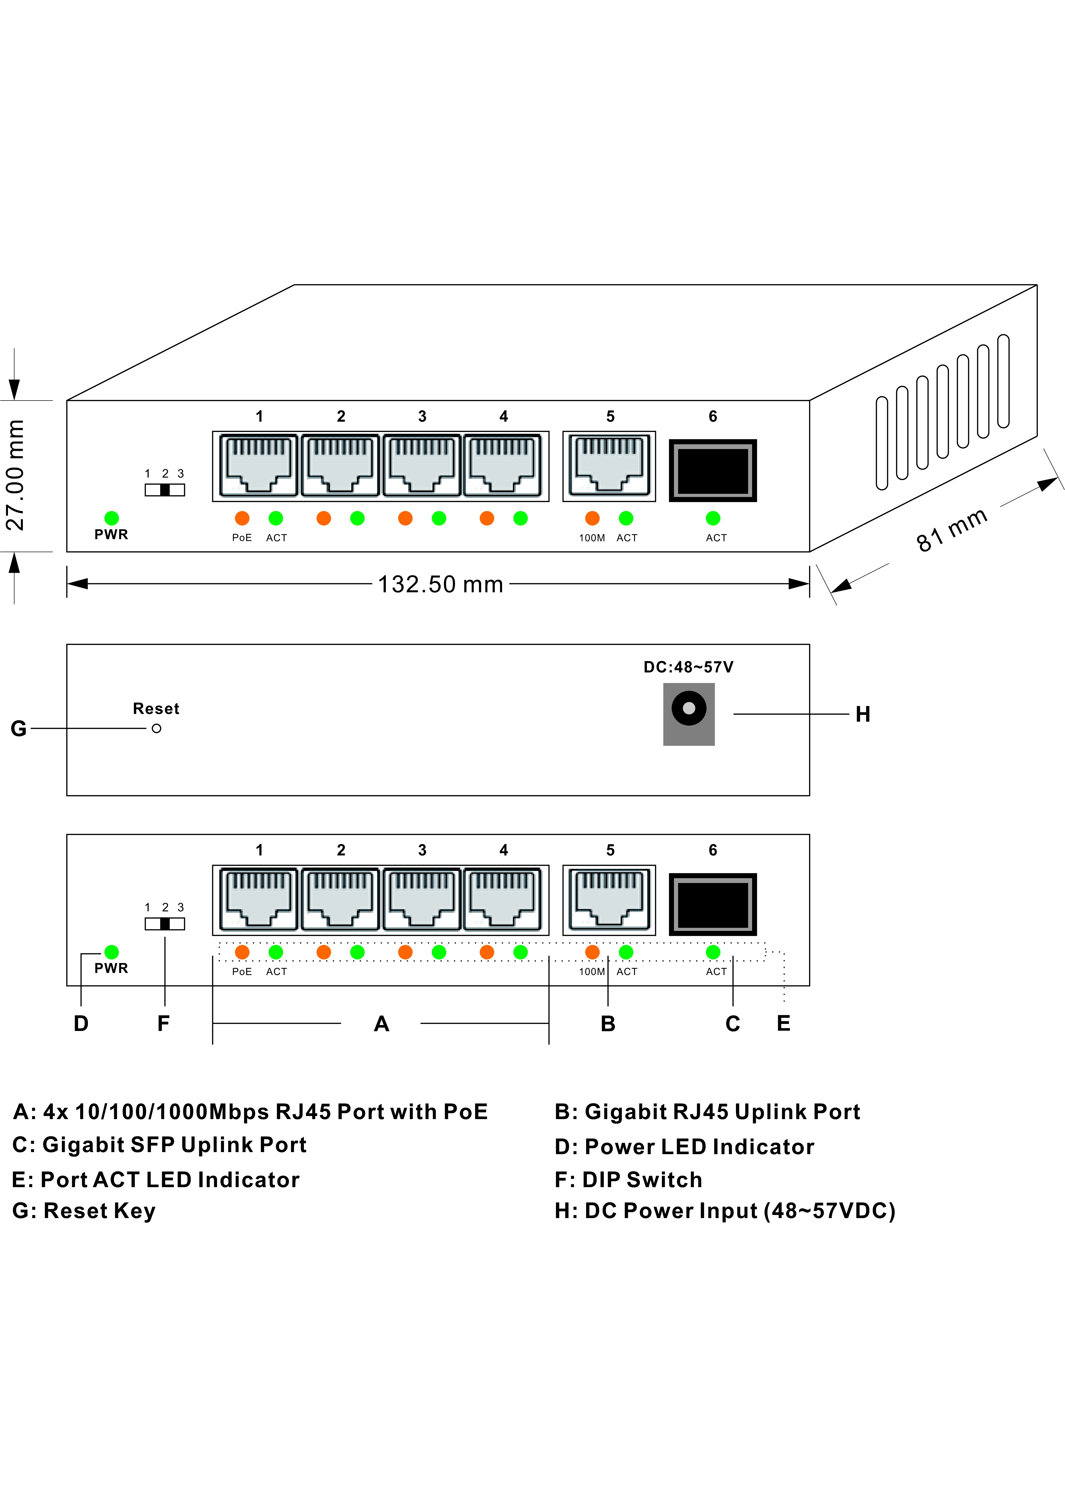
Technical Structure and Port Description
4

Slide 4
Panel Description
Indicator | Status | Description
System Indicator：SYS | Green LED ON | System work as normal
 | Green LED Blink | System work as normal
 | Green LED OFF | System abnormal or power off
PoE Indicator：PoE | Yellow LED ON | Connected PD device, powering properly
 | Yellow LED OFF | No connection PD or power off
Link Indicator：Link | Green LED ON | Data transmission properly
 | Green LED Blink | Connection is OK and data is being sent and received
 | Green LED OFF | No connected device
SFP uplink Indicator： | Green LED ON | Data transmission properly
 | Green LED Blink | Connection is OK and data is being sent and received
 | Green LED OFF | No data connected
Note: please confirm that the all PoE ports of PD devices are complying with IEEE802.3af/at standard.
Power: 48 VDC(46~57VDC). (More than 50 VDC recommended when used PoE+ output.
PoE Port: The PoE ports support PoE function, which can transmit data and power simultaneously if connected matching device. The LED lights on the front panel can show working status of each port.
5

Slide 5
Connection Diagram
Cat.5
Power
NRSW6GP
Fiber media converter
Cat.5
PoE Splitter
Cat.5
DC Out
6

Slide 6
Installation Help
Installation Please confirm the following things before installation:
If the PoE port meets the power requirement of the connecting devices.
If the PoE standard requirement and power wupply matches tith the power receiving device (1/2+, 3/6-(End-span), 4/5+, 7/8-(Mid-span))
If the output power of the matched power adapter is compatible with the specification in the
label of the PoE switch
Please install the PoE switch according to the following steps:
Put the PoE switch on the surface of a large and stable table, or professional installation rank
mount
Connect Positive, Minus and earth terminals as indicators on the power adapter.
Connect the Network devices to the PoE switch port though network cable.
Please don’t put heavy products on the PoE switch, and please ensure good
Note
ventilation environment for the PoE switch.
2. Please cut off the power first before plugging the power adapter.
Power
Connect the power cable, plug it into power socket, turn on the power, then the swich will automatically initialize, and LED lights status will display as following:
Except the PoE port lights, all the other lights will go through the process of “on-off-on-off”,
which means the system restoration is successful.
Power LED remains lit.
7

